Slide 1
Polymorphism in OOP with C++

Slide 2
Polymorphism
The word polymorphism(Poly + Morphism) means having many forms. In simple words, we can define polymorphism as the ability of something to be displayed in more than one form or the same entity (function or object) behaves differently in different scenarios.
Friend
Student
Son/Daughter
Person
Brother/Sister
Customer
Biker

Slide 3
An Example of Polymorphism
The “+” operator in C++ can perform two specific functions at two different scenarios i.e when the “+” operator is used in numbers, it performs addition.
int a = 10, b= 20; int sum = a + b; //sum = 30
And the same “+” operator is used in the string, it performs concatenation.
string s1 = "University", s2= "Students";
string s = s1 + s2; //s = University Students

Slide 4
Types of Polymorphism
Polymorphism
Static/Compile Time
Dynamic/Run Time
Function Overloading
Operator Overloading
Function Overriding
Virtual Function

Slide 5
Compile Time Polymorphism
This type of polymorphism is achieved by function overloading or operator overloading.
Function Overloading: When there are multiple functions with same name but different parameters then these functions are said to be overloaded. Functions can be overloaded by change in number of arguments or/and change in type of arguments.

Slide 6
Function Overloading
Function overloading is a feature of object-oriented programming where two or more functions can have the same name but different parameters.
The function overloading feature is used to improve the readability of the code.
It is used so that the programmer does not have to remember various function names.

Slide 7
Rules of Function Overloading
Functions have different parameter type like,
sum(int a, int b); sum(double a, double b).
Functions have a different number of parameters like,
sum(int a, int b); sum(int a, int b, int c)
Functions have a different sequence of parameters like,
sum(int a, double b); sum(double a, int b).

Slide 8
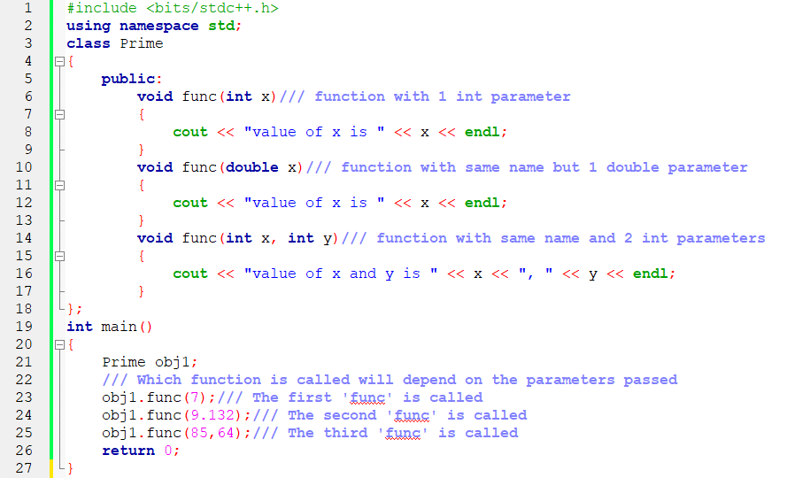
Compile Time Polymorphism(Function Overloading)

Slide 9
Compile Time Polymorphism
Operator Overloading: C++ also provide option to overload operators.
For example, we can make the operator (‘+’) for string class to concatenate two strings. We know that this is the addition operator whose task is to add two operands.
So a single operator ‘+’ when placed between integer operands , adds them and when placed between string operands, concatenates them.
The advantage of Operators overloading is to perform different operations on the same operand.

Slide 10
Rules of Operator Overloading
Existing operators can only be overloaded, but the new operators cannot be overloaded.
The overloaded operator contains at least one operand of the user-defined data type.
We cannot use friend function to overload certain operators. However, the member function can be used to overload those operators.
When unary operators are overloaded through a member function take no explicit arguments, but, if they are overloaded by a friend function, takes one argument.
When binary operators are overloaded through a member function takes one explicit argument, and if they are overloaded through a friend function takes two explicit arguments.

Slide 11
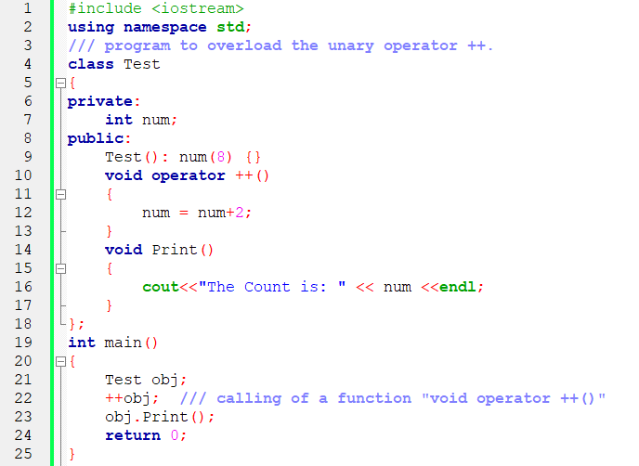
Compile Time Polymorphism(Operator Overloading)

Slide 12
Run Time Polymorphism
This type of polymorphism is achieved by Function Overriding.
Function overriding on the other hand occurs when a derived class has a definition for one of the member functions of the base class. That base function is said to be overridden.

Slide 13
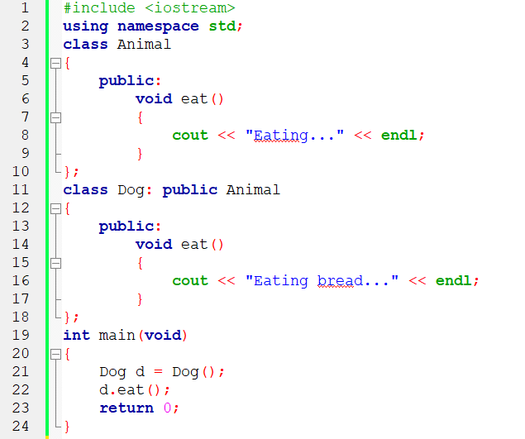
Run Time Polymorphism(Overriding)

Slide 14
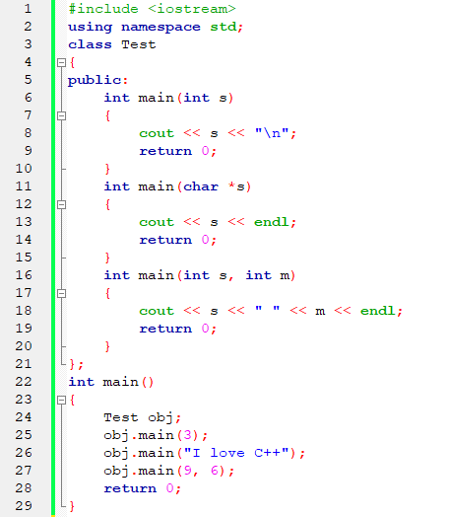
Overloading main() function in C++

Slide 15
Function Overloading VS Function Overriding in C++
Inheritance: Overriding of functions occurs when one class is inherited from another class. Overriding can occur without inheritance.
Function Signature: Overloaded functions must differ in function signature ie either number of parameters or type of parameters should differ. In overriding, function signatures must be same.
Scope of functions: Overridden functions are in different scopes; whereas overloaded functions are in same scope.
Behavior of functions: Overriding is needed when derived class function has to do some added or different job than the base class function. Overloading is used to have same name functions which behave differently depending upon parameters passed to them.

Slide 16
Thank You

